Slide 1

CYBER EDGE
CYBER EDGE
Group 4

Slide 2

THE TEAM
Group 4
PRIYANSHU DAS
ASHISH SRIVASTAVA
RAKESH CHOUDHARY
HARISH PRAKASH SINGH

Slide 3

AGENDA
Problem Statement
Proposed Solution
Technical Details
Demo
Further Enhancements
Q&A

Slide 4
PROBLEM STATEMENT
Objective
Managing the security posture of multiple servers and virtual machines (VMs) in an enterprise environment is challenging. Administrators often struggle to keep track of security vulnerabilities, outdated software, and unpatched systems.
Additionally, conducting compliance checks using OpenSCAP and CIS benchmarks requires manual intervention, making it inefficient and error-prone. There is a need for an automated, centralized, and user-friendly solution that provides real-time security insights and compliance reports for all managed servers.

Slide 5

PROPOSED SOLUTION
LET’S DIVE IN

Slide 6
SOLUTION
The Security-Centric Server & VM Management Tool is a web-based platform that enables administrators to monitor and enforce security best practices across multiple servers. It consists of the following components:
React-based Web Dashboard
Host Agent (Backend Server)
Guest Agent (Client Script)

Slide 7

Background Details
Understanding OpenSCAP Workbench

Slide 8
What is OpenSCAP Workbench
OpenSCAP Workbench is a powerful tool designed for compliance assessment and security automation. It is part of the OpenSCAP ecosystem, which supports the Security Content Automation Protocol (SCAP) framework. Here are the core aspects of OpenSCAP Workbench:
Compliance Checking: It assesses system configurations against predefined security policies and standards, such as CIS Benchmarks or DISA STIGs.
Customizable Profiles: Users can modify security policies by enabling or disabling specific rules and saving these changes as tailoring files.
Automated Reports: It generates detailed reports that summarize compliance results, highlighting areas that need remediation.
Remediation Support: Based on the scan results, it provides recommendations or scripts to fix identified issues.
Efficient Scanning: It can perform system scans to identify security vulnerabilities and non-compliant configurations.

Slide 9
Utilization of OpenSCAP Workbench in the Project
Compliance Checks: Validates system configurations against CIS benchmarks.
Automated Scanning: Assists in system assessment by collecting data via agents.
Report Analysis: Offers actionable insights for compliance enforcement.
Guidance: Facilitates decisions for system hardening and regulatory adherence.

Slide 10
Checking Compliance with CIS Benchmark
The CIS (Center for Internet Security) Benchmarks are a set of best practices and guidelines developed to help organizations secure their systems and data. These benchmarks are widely recognized standards that provide specific configuration recommendations to improve the security posture of various IT systems, applications, and devices. Key Features of CIS Benchmarks:
Platform-Specific Guidelines: Benchmarks are available for operating systems, cloud environments, databases, and network devices.
Customizable: Recommendations can be adapted to fit an organization's unique needs and requirements.
Community-Driven: Developed and maintained by cybersecurity experts and practitioners from around the world.
Using CIS Benchmarks helps ensure that systems are configured securely, reducing vulnerabilities and strengthening defenses against cyber threats.

Slide 11
FEATURE BREAKDOWN
📝 OpenSCAP Hardening Reports
Runs compliance scans and sends results to the host.
🔓 Open Ports Scan
Lists open network ports.
📦 Patching Status
Checks for available updates.
🛠️ Third-Party Software Inventory
Lists installed packages.

Slide 12
KEY BENEFITS
✅ Centralized Security Management: Monitor multiple servers from a single dashboard.
✅ Automated Compliance Reporting: Uses OpenSCAP with CIS benchmarks for security hardening.
✅ Real-time Insights: Helps administrators quickly identify and address vulnerabilities.
✅ User-friendly Interface: Provides a clean and intuitive UI for easy navigation.
✅ Lightweight & Efficient: Uses SQLite, React, and Node.js for a scalable and low-resource solution.

Slide 13
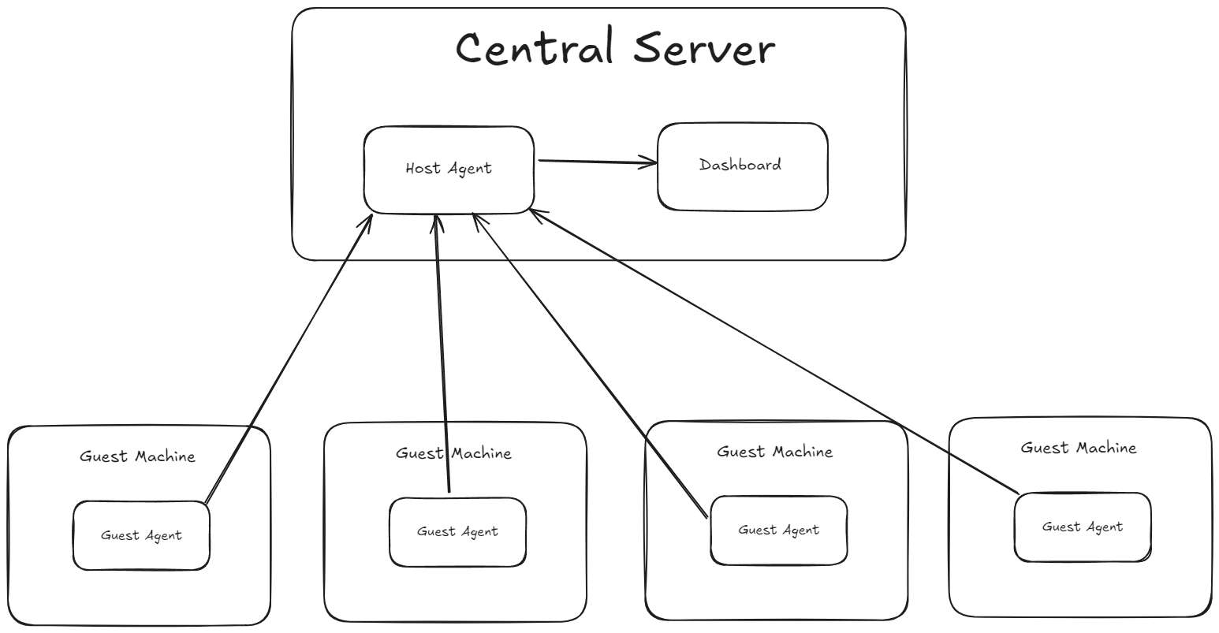
HIGH LEVEL DESIGN

Slide 14
TECHNICAL DETAILS

Slide 15
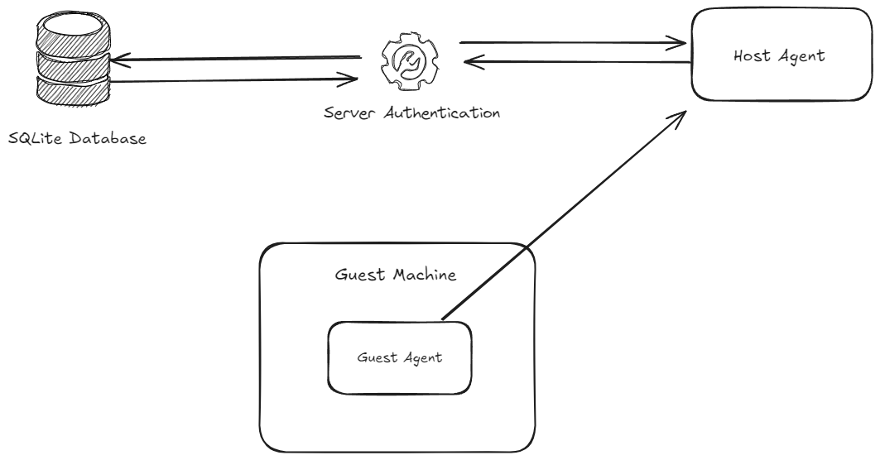
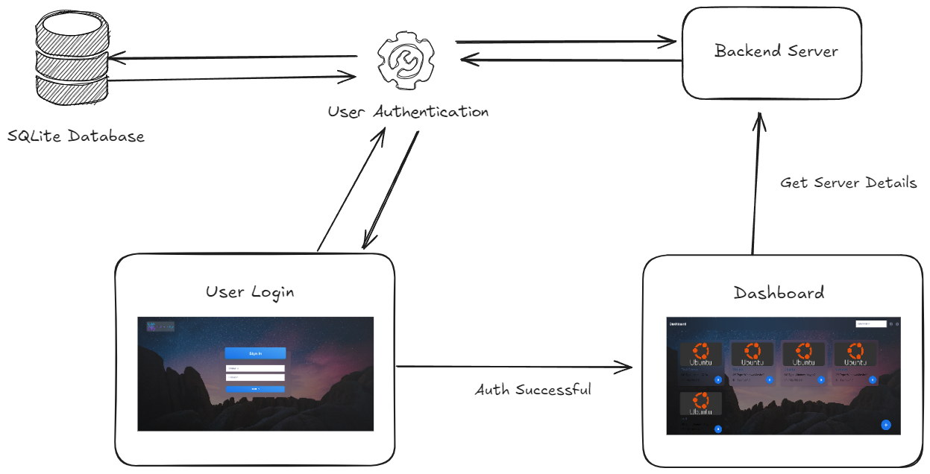
SYSTEM DESIGN

Slide 16
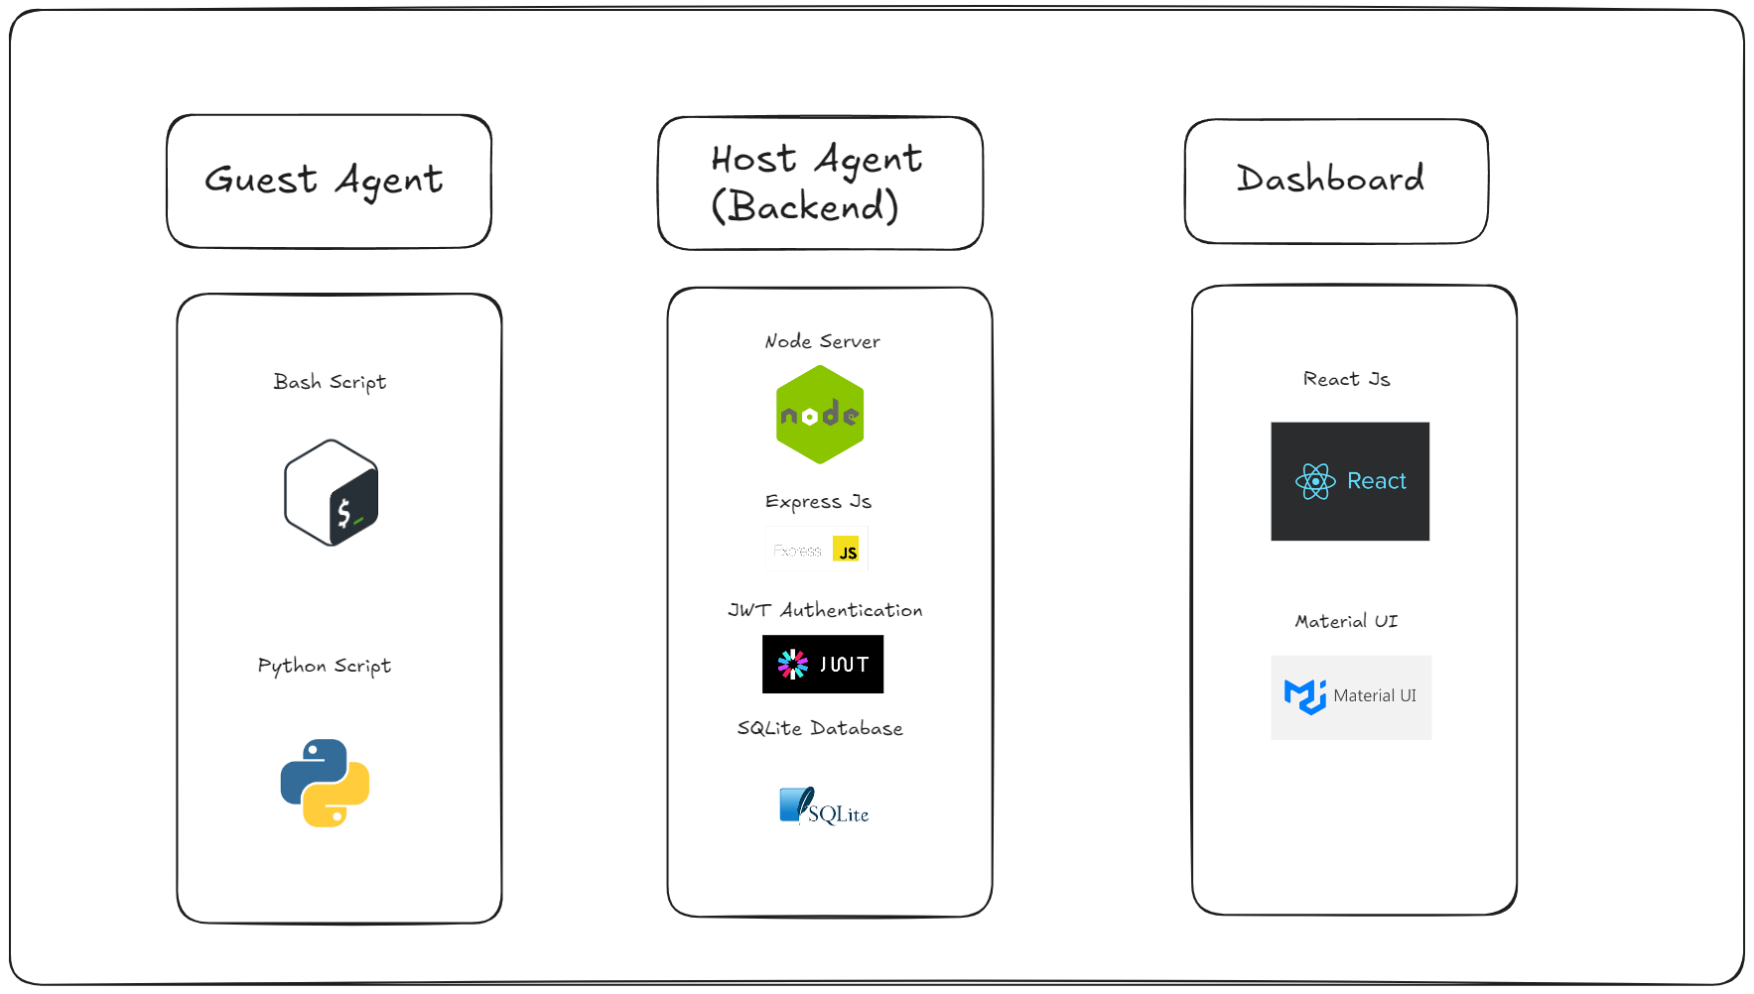
TECH STACK

Slide 17
DEMO

Slide 18
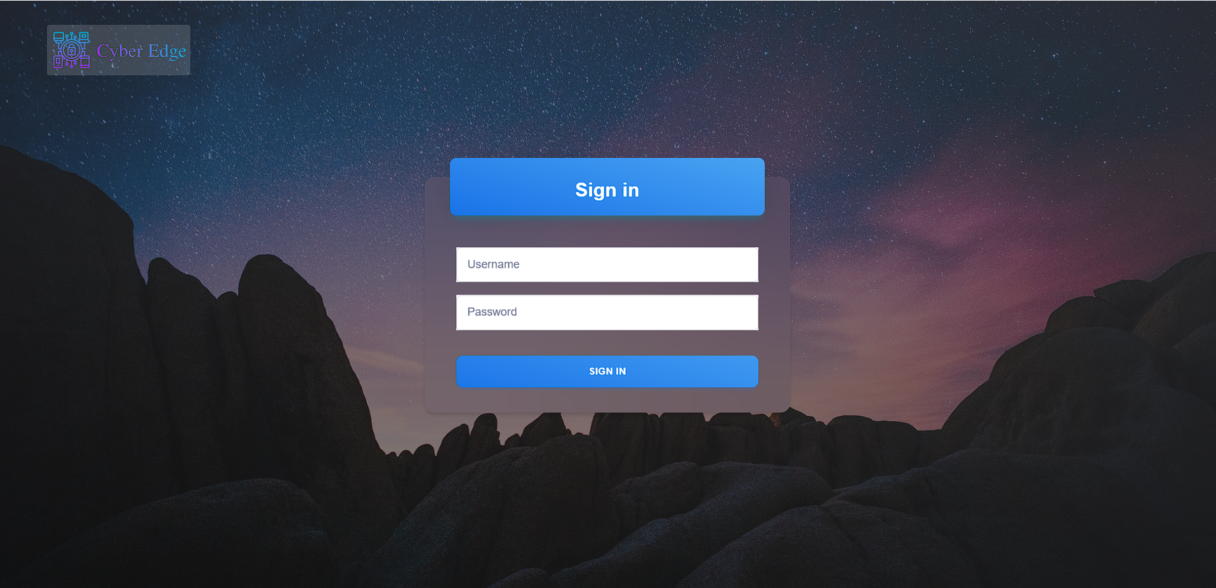
LOGIN PAGE

Slide 19
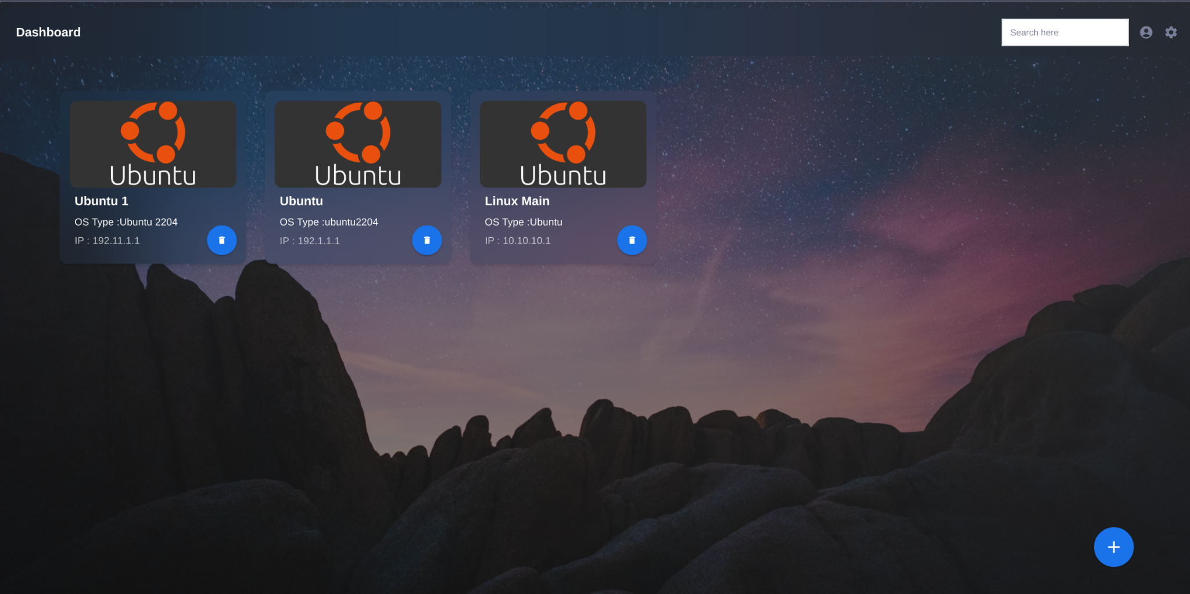
DASHBOARD

Slide 20
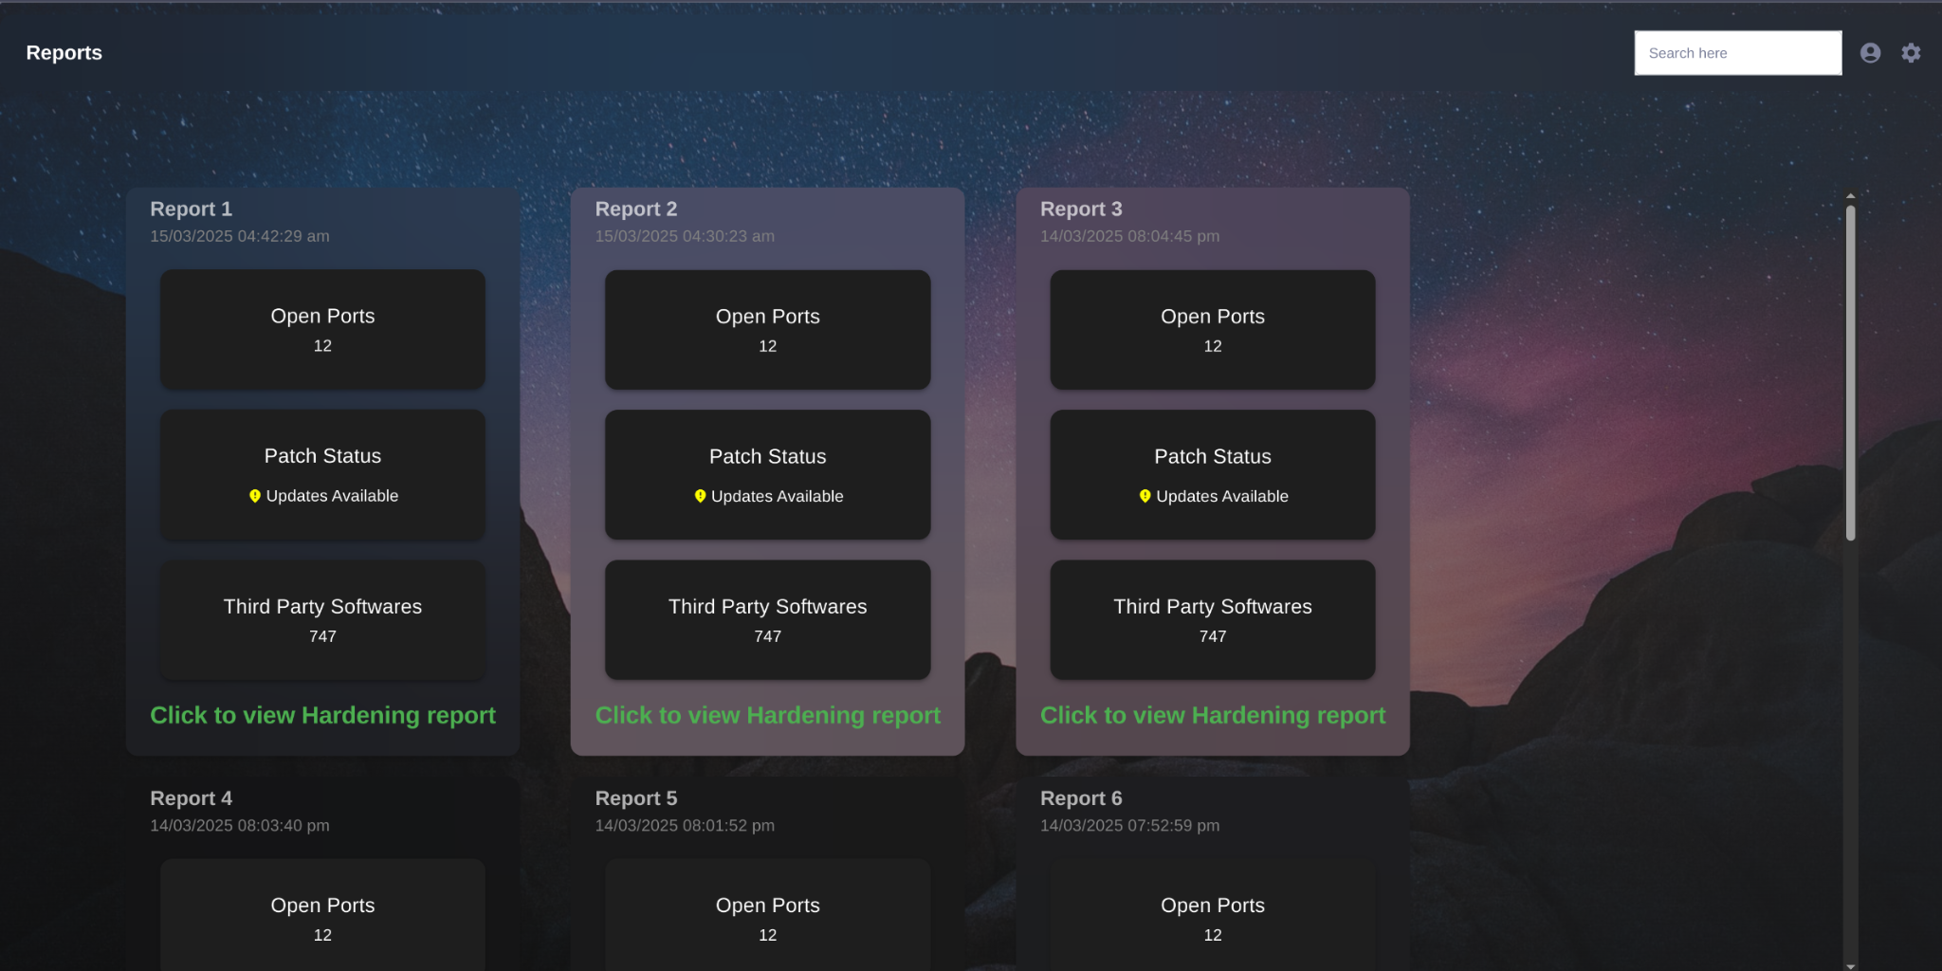
REPORTS

Slide 21
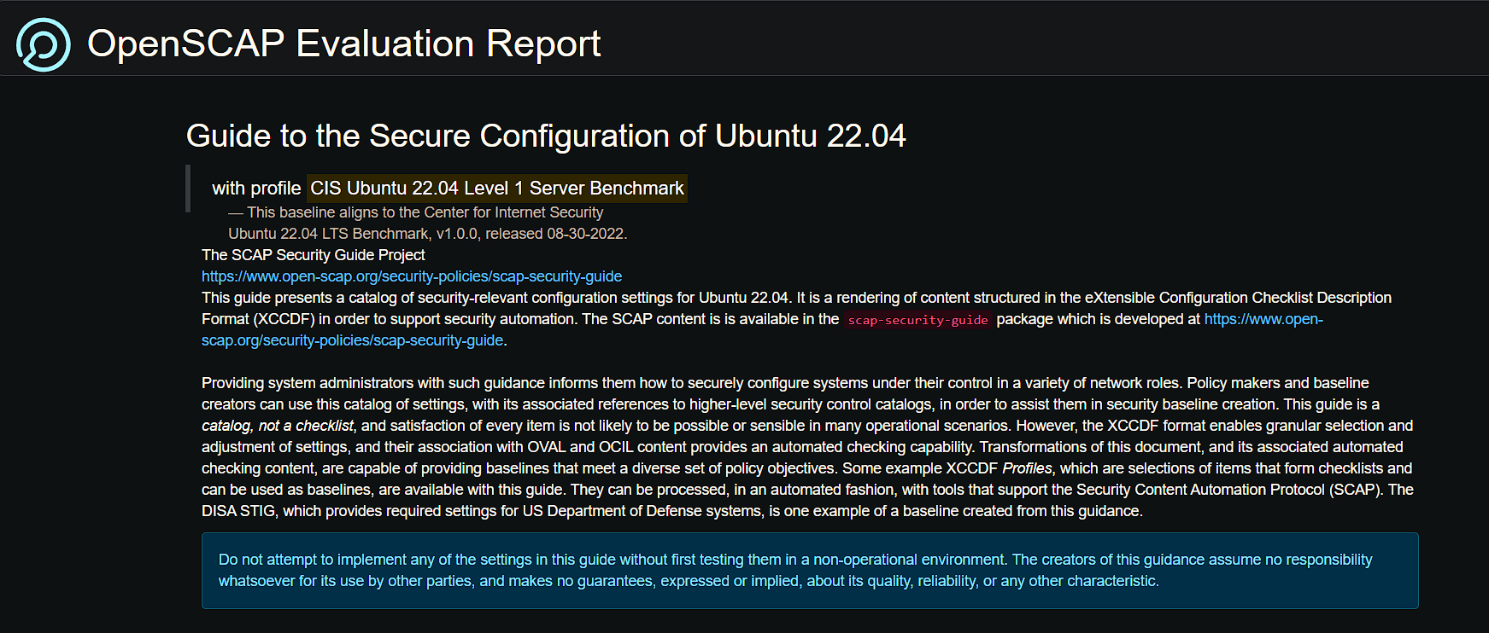
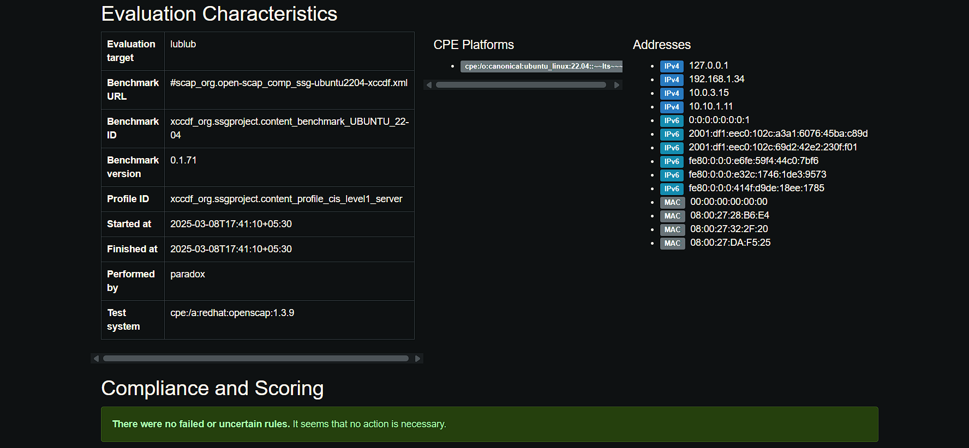
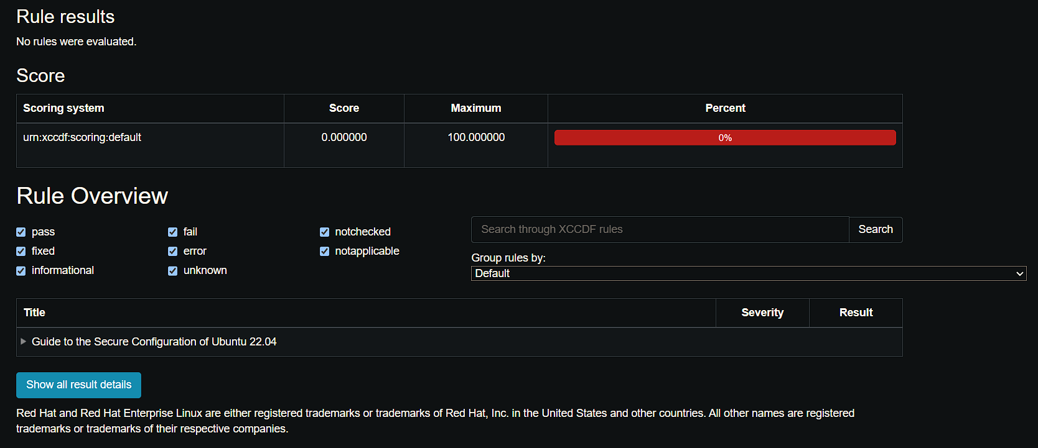
OPENSCAP CIS BENCHMARK REPORT

Slide 22
FUTURE ENHANCEMENTS
Vision

Slide 23

Many security policies are readily available online in the form of standardized SCAP checklists. However, a universally applicable security policy does not exist, as each organization has distinct security requirements and operational needs.
To enhance both the capabilities and user experience of the product, additional functionalities can be integrated. These include connecting the portal to an organizational repository or the web, enabling the retrieval of the latest security policies for download and installation on flagged client machines.
Furthermore, remote patch automation can be implemented, allowing seamless installation of security patches across multiple devices. This not only improves security and compliance but also enhances user experience by reducing manual effort, minimizing downtime, and ensuring a more efficient and intuitive patch management process.

Slide 24
Cross-Platform Support: Improve compatibility for both Windows and Linux environments
Advanced Threat Detection: Integrate AI for detecting intrusion and threats.
Option to manage - Scheduled Scans & Alerts – configurable by Admin
More In-Depth Scanning and Report Generation
Email/Slack/SMS Notifications and reports
System Telemetry, Graphical Data Visualization for quick overview and issue flagging.
Role-based access for teams.
Data Aggregation Enhancements.

Slide 25
Conclusion
Cyber Edge

Slide 26
ANY QUESTIONS?

Slide 27
THANK YOU
CYBER EDGE

